Slide 1
Lightning Introduction
2013-11-27

Slide 2
Contents
Company Profile
Market Trends
Our Commitments to QFN
Technology Roadmaps.
Our plan

Slide 3

Company Profile
Lightning Optoelectronic Technology (SZ) Co., Ltd was established in 2004.
LIGHTNING is a High Tech Enterprise which integrated R&D, Product and Sales to focus on Lighting-Class LED Components Packages business.
The company offers LED Components, LED Modules and LED Lighting Solutions for clients from all over the world.

Slide 4
LIGHTNING Overview
2004
·LIGHTNING Founded
2005
·Mass Produced Hi-power White LED
2006
·Hi-power LED Automatic Product Line Operated
2007
·SMD Automatic Product Line Operated
·Brought in Strategic Investors，Started to Construct Middle and High Power SMD Series; 2010 start EMC/SMC QFN development & production.
2009
·100KK/M for Middle Power SMD LED
· 10KK/M for High Power SMD LED
Qualified by Key Europe and Japan customer.
·Middle and High Power SMD Series Completed
2011
2012

Slide 5
Our Mission: Focus on improving people’s live through scientific and technological innovation in LED field.
Our Vision: We will become the global LED chip leader through scientific and technological innovation, we will deliver superior value for our customer, we will be the best place to work for people who share our passion.
Our Value: Focus on customer, develop through scientific and technological innovation, build up brand with professionalism.

Slide 6
Our Strategy
Partner with leading customers, content and service providers in Lighting Business.
Develop customer solutions based on leading technology that combine LED chips, package & materials.
Manage a balanced & competitive portfolio spanning emerging, growth and mature products.

Slide 7




Our Philosophy
Pursuing Higher Quality
LIGHTNING
Quality
Innovation
Win-Win
Focus
Focus on
LED package
Keep Innovating
Company and employees
Company and customers

Slide 8
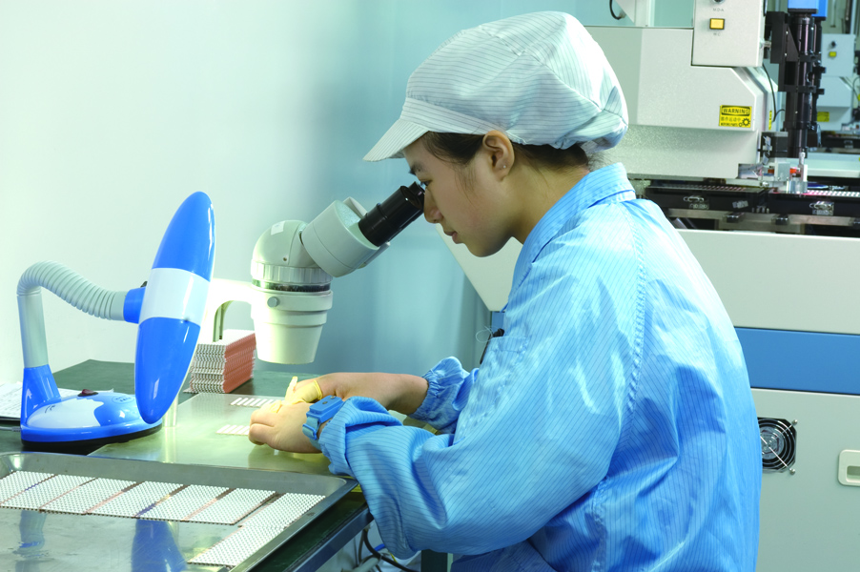

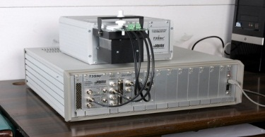
People-oriented, full scope to the talents
Our Professional Teams
High-level Management Team
Administration
High Efficiency Marketing Team
Marketing Center
ERP and CRM was led into
Professional production team
Manufacturing Center
Professional Customer service team
Lighting Solution Center
Professional R & D team
Research and Development Center

Slide 9
Market Trends

Slide 10
LED Lighting Market Trends
Important data of Policy Development for USA LED Lighting
Item | VIP Data
Cost of LED Chips | 2020 cut 82% than 2012
Cost of LED Package | 2020 cut 78% than 2013
Price of LED Package | 2020 $0.7/klm, cut 90% than 2012
LED Package Luminous flux efficiency | 2020 Warm White 224lm/W, 2 times than 2012
 | 2020 Cool White 235lm/W, 1.6 times than 2012
Cost of 60W LED Bulbs | 2020 cut 66% than 2013
Lighting Start 2013
Lighting Market
Source : USA DOE LED Lighting program
Steadily growth 2014
Key Success factors
Package cost
Lm/$
LOP /Overdrive
System costs
Explosion growth 2015

Slide 11
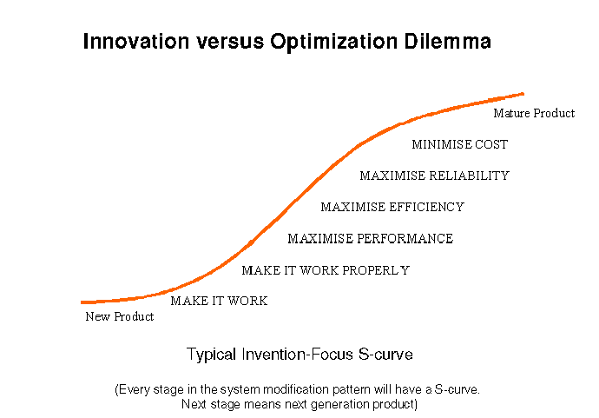
Our Position in Market place
S-Curve : EMC/QFM Adoption Rate
Adoption %
We are here
Nichia
Lightning
Lumanmax
Everlight
LGIT
Hongli
Refond
NationStar
Time
Lextar

Slide 12

Mid-Power, Hi-Power support the development of LED lighting industry
Illuminate the World
Indoor lighting
Outdoor lighting
Home Lighting
Industry and commerce lighting
Mid-Power SMD
Series
3014
3020
Hi-Power SMD
Series
3535
9292
3030
5050
business need : Satisfying kinds of lighting demand with simple types of LED to cut lighting system cost.

Slide 13
Our Commitments

Slide 14
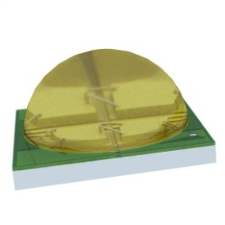
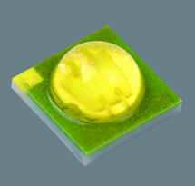
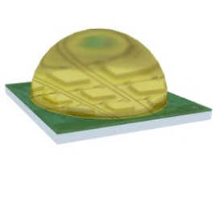
Hi-Power Ceramic LED platform
3535
（1-4W）
90-130lm/W
5050
（5-10W）
90-130lm/w
9292
（10-25W）
90-130lm/w

Slide 15
Lightning Middle-Power Series
3014
0.06-0.4W
110-180lm/W
3020
0.06-0.7W
110-180lm/W
3030
0.7-2w
110-180lm/W

Slide 16
Our Home & Partner

Slide 17





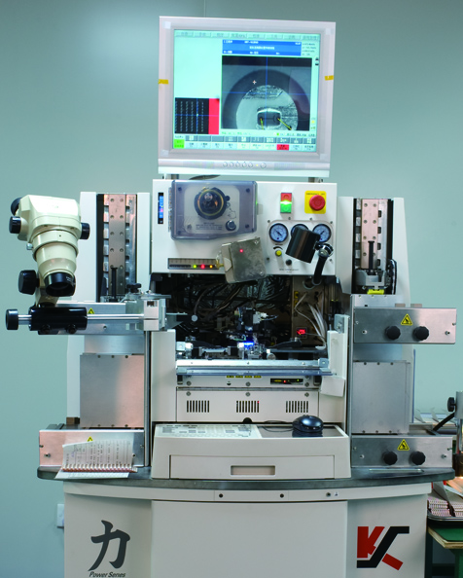
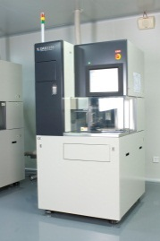
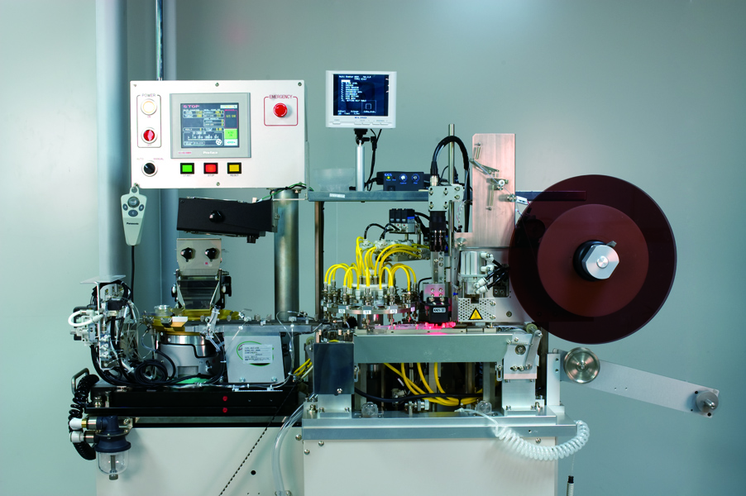
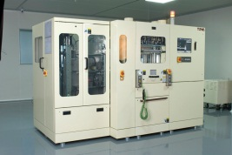
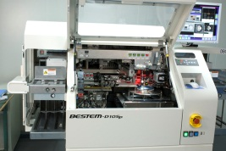
Advanced Production lines
Spectroscopical and Taping machine
Molding machine
Die Bonding machine
Wire Soldering machine
Cutting machine
In house Pre molding has better cost structure than competitions.

Slide 18





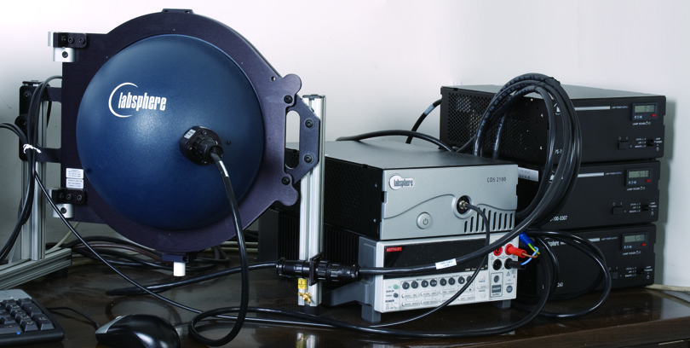
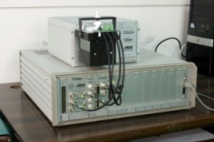
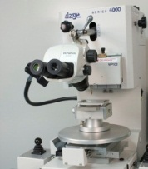
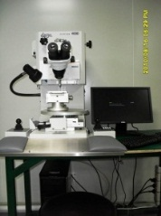
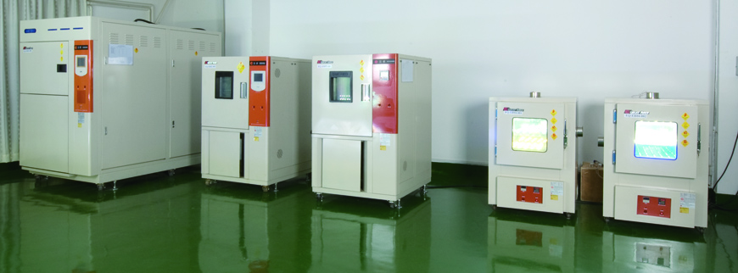
Advanced testing lines
Labsphere Testing system
Heat-resistant Tester
Giant-force LM-80 Tester
Push-pull effort Tester
Xray Imager
In house Pre molding has better EMC/SMC QFN products quality.

Slide 19








Top Raw Materials Suppliers

Slide 20
Why SMC&EMC QFN?

Slide 21
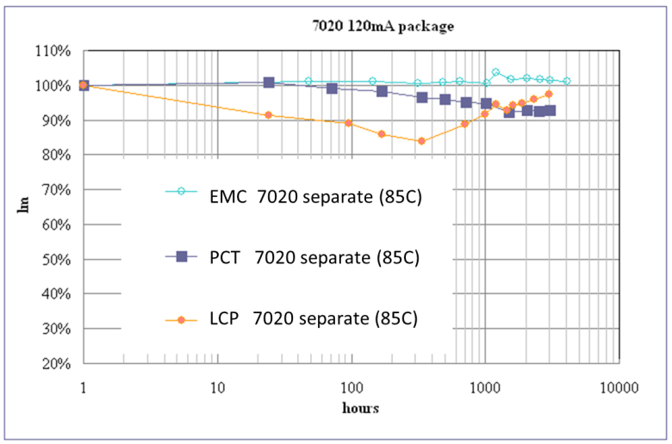
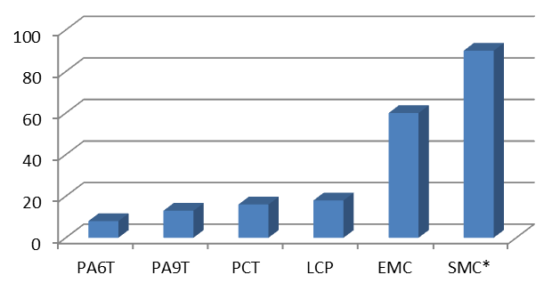
EMC/SMC QFN Advantages
 | PA 6T | PA 9T | LCP | PCT | Epoxy | Silicone
Reflectivity | 95 | 97 | 87 | 88 | 92 | 93
Thermal stability | × | ❒ |  |  |  | 
Light stability |  |  | × |  |  | 
Physical properties |  |  |  | ❒ |  | ❒
Productivity |  |  |  |  | ❒ | ❒
Mold method | Injection | Injection | Injection | Injection | Transfer | Transfer
Cost |  |  |  |  | ❒ | ×∼
Best
Good
Middle
× Bad
Existing PLCC
Lightning QFN
Price, 10k RMB/t
Lifetime of package level: EMC > LCP > PCT > PPA
Cost: SMC > EMC > LCP > PCT > PPA
Source : Hitachi Materials

Slide 22
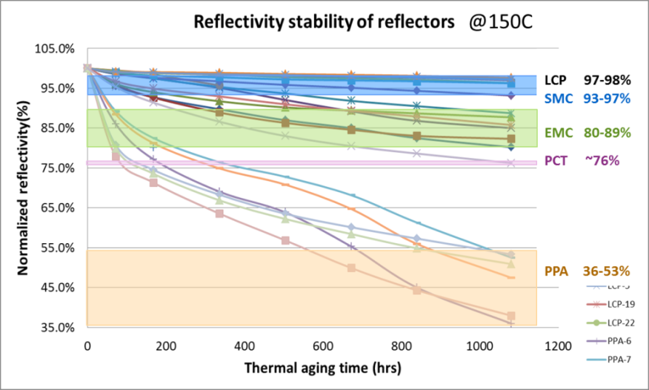
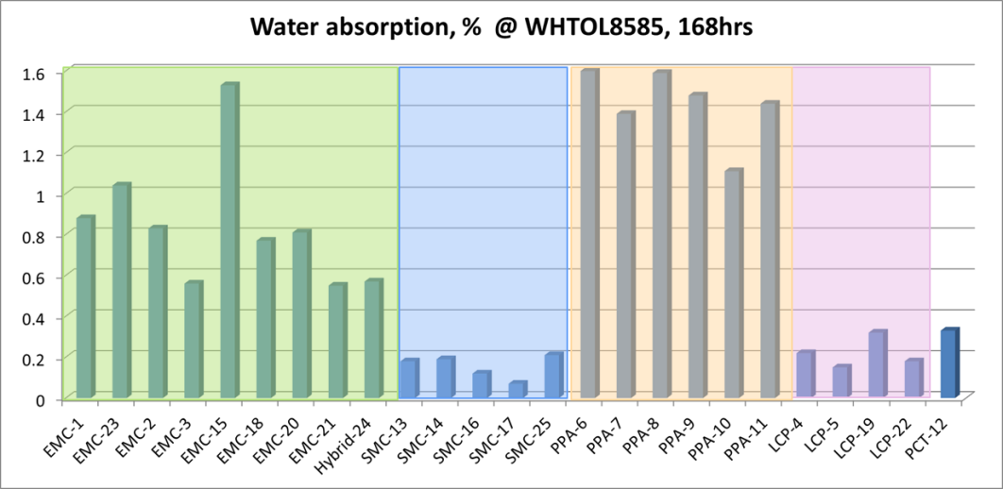
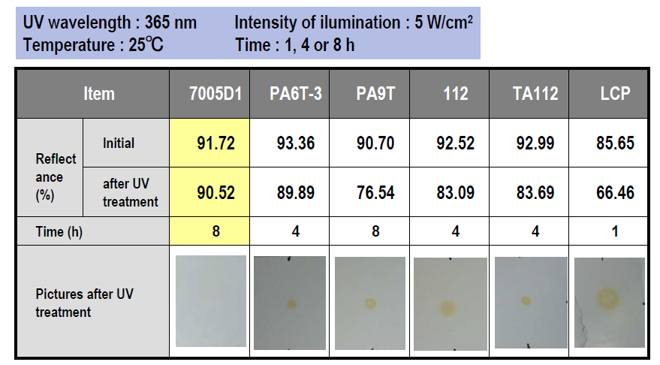
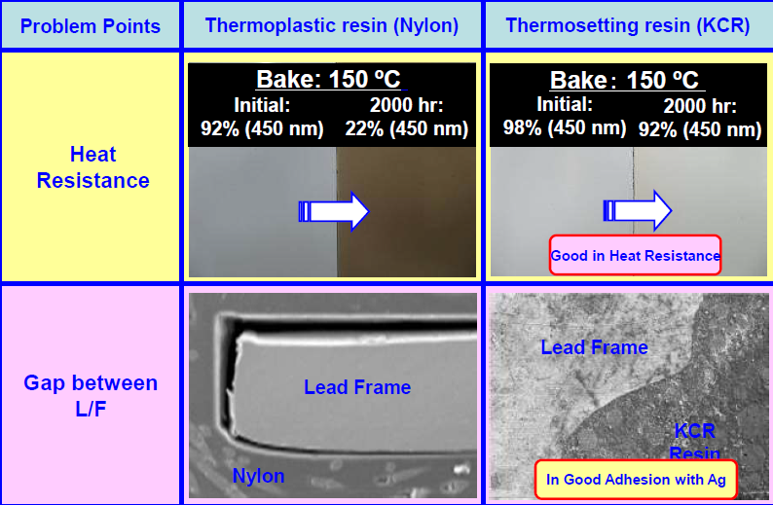
EMC/SMC outperforms PPA
1. Thermal
2. UV
3. Moisture
4. Ag Adhension
1. Thermal stability priority: LCP~SMC > EMC> PCT >PPA
2. UV stability : EMC >> PPA >LCP
3. Moisture prevention performance: SMC > LCP > PCT > EMC > PPA
4. Adhesion with silver: EMC>PPA
Source : HKUST

Slide 23
Our Plan

Slide 24
Unit: million USD ＄
Invested
62$
Plan to invest
150$

Slide 25
Hand in hand, we are going to light up the whole world together!
Thank you !

